Slide 1
Chapter 1: Introduction
Overview of ICT and Computer Science
Knowledge Hierarchy (Data, Information, Knowledge and wisdom)
What is an Information System?
Components of Information Systems
Applications of IS/ICT

Slide 2
Chapter 1
Computers and Communications: “These are the parents of the information age,” says one writer. “When they meet the fireworks begin.”
Computer Technology: A Computer is a programmable, multiuse machine that accepts data, raw facts, and figures, and processes or manipulates it into information we can use, such as summaries, totals, or reports. Its purpose is to speed up problem solving and increase productivity.
Notes:
Can you give examples of communication devices (technologies) used to transmit large amounts of data through long distances?
ICT can give countries something else to sell. What do you think it is?
Skilled man power as well as products and software!

Slide 3
Communications Technology: Communications, or Telecommunications technologies consist of electromagnetic devices and systems for communicating information over long distances. The principal examples are telephone, radio, broadcast television, cable TV, and other telecom technologies.
Information Technology (IT) is technology that merges computing with high speed communication links carrying data, sound, video, and other forms of multimedia.
Information Communications Technology (ICT) is a generic name used to describe a range of technologies for creating, finding, storing, gathering, retrieving, processing, analysing, sharing, and transmitting information
Notes:
We can say that ICT is about using IT for the benefits of society or groups of people.
We may consider IT as the infrastructure and ICT as applied on top to bring change: they are like body and soul.
Sometimes we may loosely take IT and ICT as synonyms (as another name for the other): as though both are referring to the same thing
Thus, we use them interchangeably as they fit right based on industry practice
ICT can be considered to be built on the 4Cs, Computing, Communications (Connectivity), Content, and (human) Capacity
In my view, if we consider large areas and large groups of people (schools for example) ICT comes to the front,
while we consider organizations and industries IT comes to the front.

Slide 4
Cont…
The two technologies were developing independently, before they gradually fused together.
Why have the worlds of computers and telecommunications remained so long before coming together?
Technological Convergence, also known as digital convergence, is the technological merger of several industries through various devices that exchange information in the electronic, or digital, format used by computers. The industries used are Computers, Communications, Consumer Electronics, Entertainment, and Mass media.
What are five developments growing out of the fusion of computers and communications? (refer to using information technology, 9th edition, Williams/Sawyer)
Notes:
Convergence describes the combining of several industries through various devices that exchange data in the format used by computers.
[Q] Can you give some examples of technologies that are results of convergence?
The Cloud, Internet telephony, and Internet through sets are some examples of convergence.
Other telecom services: such as broadband, VPN, etc.
Mass media: Television, Radio, and Newspapers.
The answer to the question is: Computers were digital while most of the world was analog.

Slide 5

What is Computer Science?
CS is designing computing devices and programming them
A lot of work in CS is done with pen and paper!
Computer science is the study of algorithms and much more than this …
A lot of computer science is about improving technology-- making it faster, smaller, cheaper or able to do new things through developing new theories.
Notes:
It is about architecture and abstraction of complex reality.
It is about developing new theories, as a result new technologies can be developed.
Software Engineering is a branch of Computer Science.
Principles (theories) have a long lifetime while technology tends to change every decade or so.
Algorithms are high level abstractions of computer programs.

Slide 6
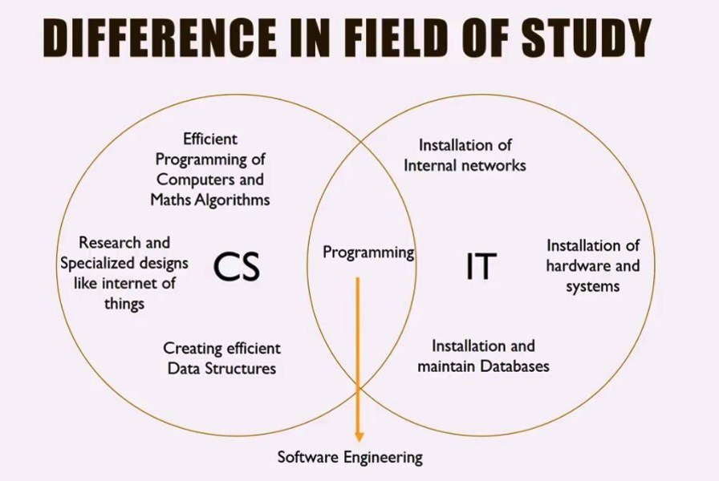
Notes:
IOT and cars! when you approach home the air conditioner will start working …
Trouble shooting through the internet.
Smart fridges, smart cars, smart homes;
Thinking is done in the left, Practical application (of Computers and other Technologies) in the right side
At the overlapping region the two fields work together (through programming).
Successful software development is achieved through Software Engineering principles.

Slide 7
Computer science is programming intensive
Involves
system architecture
software engineering
application programming
hardware engineering
theory
Information Technology is associated to organization related applications
business related
organizational automation
ICT is a Change Agent (Enabler)
Notes:
Architecture: The art or practice of designing and constructing
IT (HW & SW) supports organization processes!
Process → Activities (phases) → Tasks → techniques
Actually HW supports SW, and SW supports Processes (People and their activities)
Computer Science is about analytical thinking and logical reasoning.

